Slide 1
The data engineer’s journey
Murzabekov Almaz
Moscow, 2020

Slide 2



A data engineer’s dream
Magic
Data

Slide 3
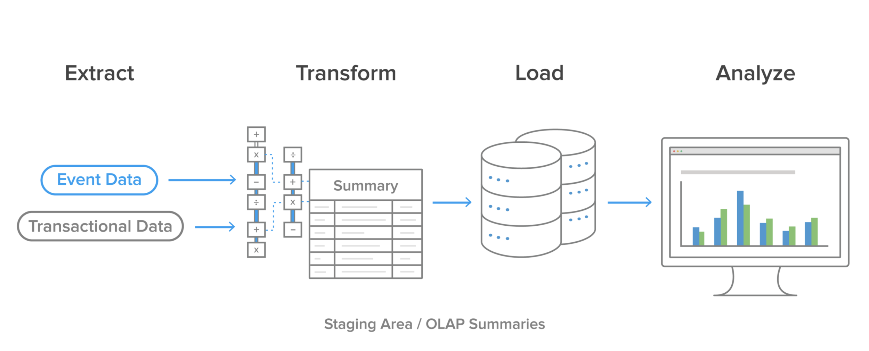
ETL-processes

Slide 4

The problems of ETL/ELT processes
MAINTENANCE COSTS
  spendings for additional staging area
  network, disks, io, etc usages

Slide 5

The problems of ETL/ELT processes
MAINTENANCE COSTS
  spendings for additional staging area
  network, disks, io, etc usages
NOT A (NEAR) REAL-TIME SOLUTION
  Transformation time

Slide 6

The problems of ETL/ELT processes
MAINTENANCE COSTS
  spendings for additional staging area
  network, disks, io, etc usages
NOT A (NEAR) REAL-TIME SOLUTION
  Transformation time
STRICT DATA STRUCTURE

Slide 7

The problems of ETL/ELT processes
MAINTENANCE COSTS
  spendings for additional staging area
  network, disks, io, etc usages
NOT A (NEAR) REAL-TIME SOLUTION
  Transformation time
STRICT DATA STRUCTURE
IMPACT FOR SOURCE SYSTEMS

Slide 8
LAMBDA ARCHITECTURE

Slide 9
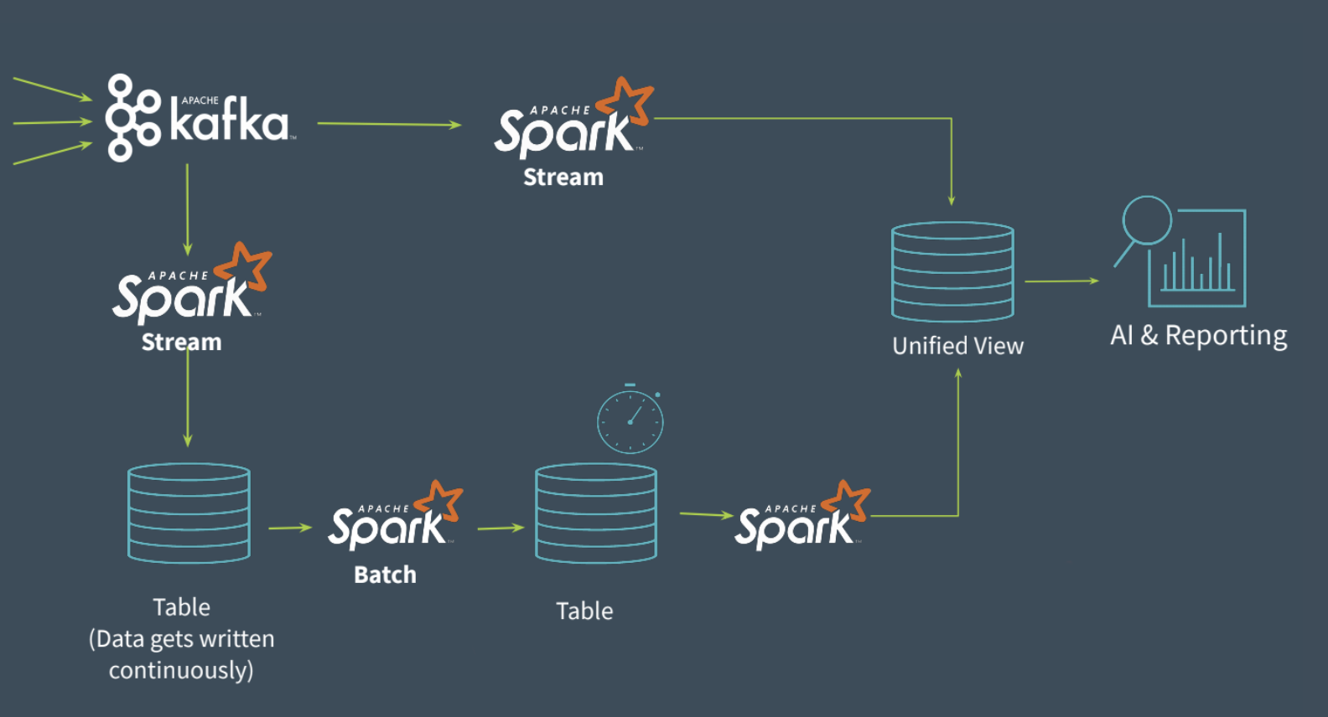
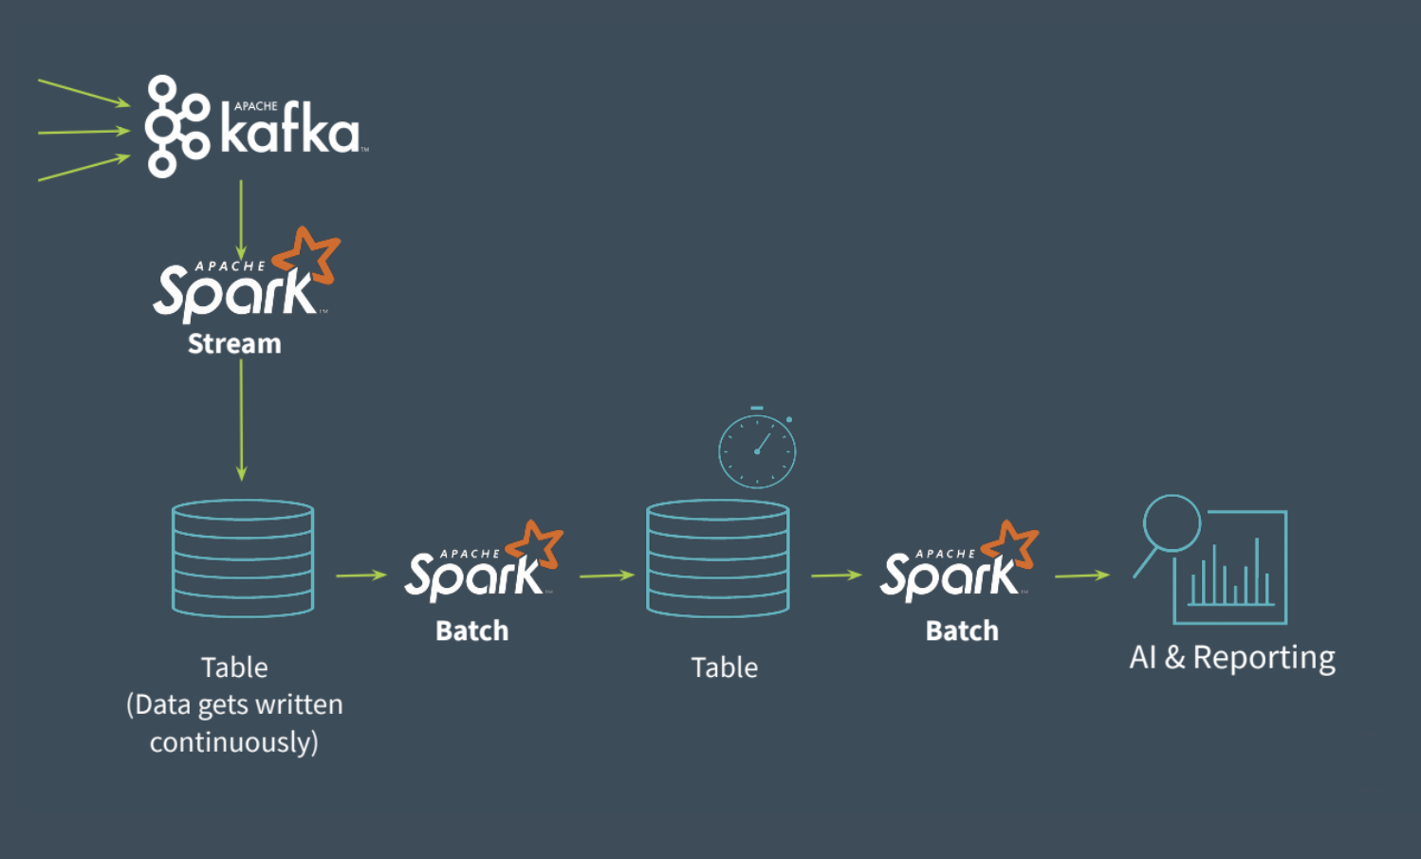
Lambda architecture

Slide 10
Lambda architecture

Slide 11
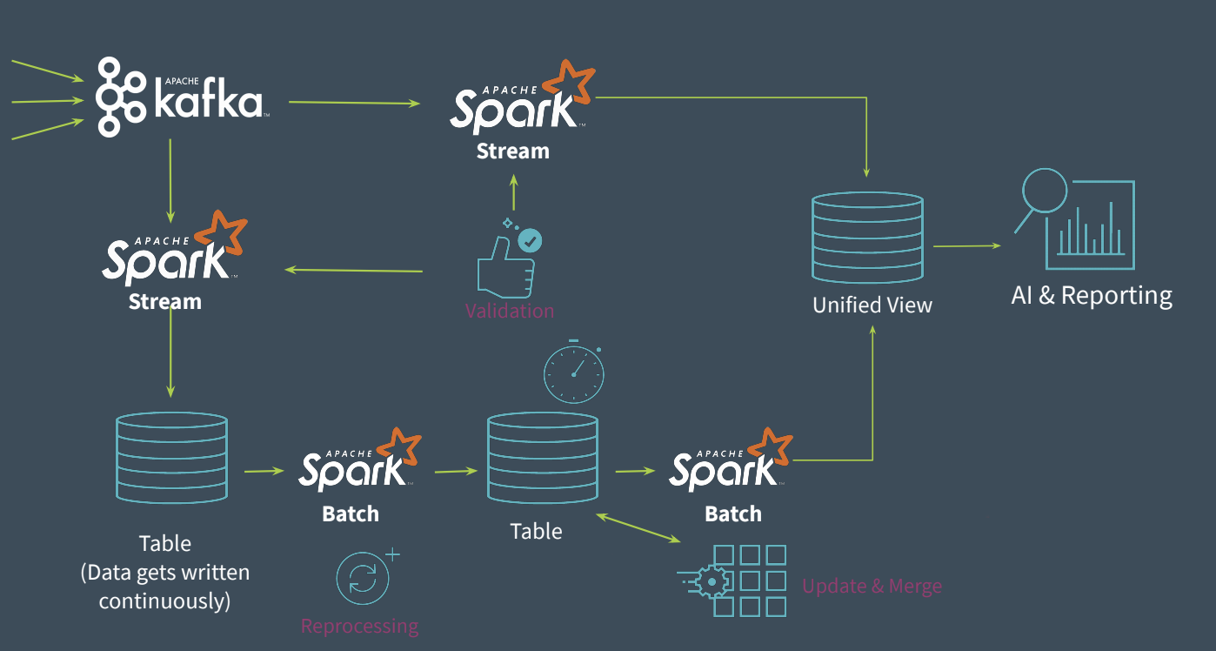
Lambda architecture

Slide 12

The problems of Lambda Architecture
CODING OVERHEAD
  Batch Layer
  Speed Layer
  Serving Layer
  Other Layers.. :-(

Slide 13

The problems of Lambda Architecture
CODING OVERHEAD
  Batch Layer
  Speed Layer
  Serving Layer
  Other Layers.. :-(
REPROCESSING HISTORICAL DATA

Slide 14

The problems of Lambda Architecture
CODING OVERHEAD
  Batch Layer
  Speed Layer
  Serving Layer
  Other Layers.. :-(
REPROCESSING HISTORICAL DATA
IT IS DIFFICULT

Slide 15
KAPPA ARCHITECTURE

Slide 16

Kappa architecture
Keep It Simple and Stupid (KISS) - a software engineering principle

Slide 17
DELTA ARCHITECTURE

Slide 18
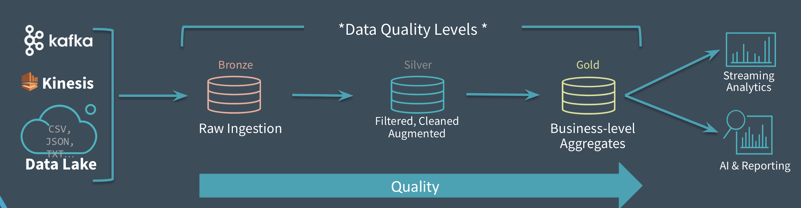
Delta architecture

Slide 19
Conclusions
There are no silver bullet
You MUST understand your data
Each architecture has own pros and cons
A good data-engineer understand the future business-needs

Slide 20
RESOURCES
Beyond Lambda: Introducing Delta Architecture: https://shorturl.at/iqRY1
Анти-введение в Big Data — Владимир Красильщик (youtube): https://youtu.be/7RhFo6U2NrY
BigПочта: как мы строили DataLake в Почте России (youtube): https://youtu.be/6JwMho6UfK4
ETL Process and The Challenges: https://softtechgroup.us/blog/etl-process-and-the-challenges
A brief introduction to two data processing architectures — Lambda and Kappa for Big Data: https://towardsdatascience.com/a-brief-introduction-to-two-data-processing-architectures-lambda-and-kappa-for-big-data-4f35c28005bb
Kappa Architecture Our Experience at ASP GEMS http://www.datascienceassn.org/sites/default/files/Kappa%20Architecture%20-%20Pros%20and%20Cons.pdf
Questioning the Lambda Architecture: https://www.oreilly.com/radar/questioning-the-lambda-architecture/
Kappa Architecture : In Practice: https://medium.com/@anishekagarwal/kappa-architecture-in-practice-b0a4870f3da6
From Lambda to Kappa: A Guide on Real-time Big Data Architectures: https://medium.com/@Talend/from-lambda-to-kappa-a-guide-on-real-time-big-data-architectures-fe63f3079d3e

